Slide 1
Site safety introduction for liquid bulk

Slide 2
Welcome
The INEOS site is a SEVESO company. Every visitor must register formally.
Safety is priority number 1. If in doubt or in dangerous situations, stop immediately!
Please read this presentation with safety rules carefully. At the end there is a test. A positive result is valid for 1 month.

Slide 3
Life Saving Rules (LSR)
INEOS has 7 Life Saving Rules. The following is strictly prohibited:
Working at height without suitable fall protection.
Being under the influence of alcohol or drugs.
Smoking/Vaping unless in the designated places.
Entering confined spaces.
Entering the danger zone during lifting work.
Working on installations without permission.
Bypassing of safeties or interlocks.
Any breach is life-threatening. Any finding leads to a permanent ban on the site.

Slide 4
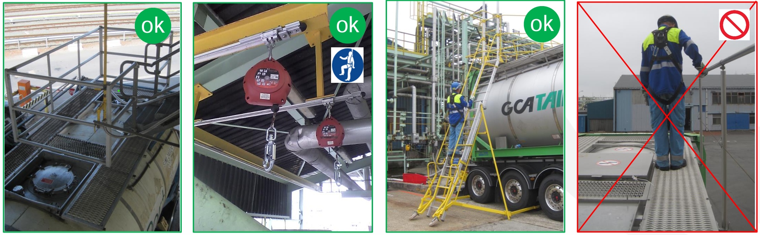
Life Saving Rules (LSR)
Working on height without suitable fall protection
Safety cage
Fall arrest device
Airplane staircase
Handrail without connected fall harness

Slide 5
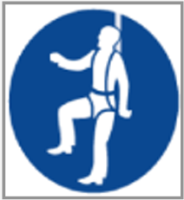

Life Saving Rules (LSR)
Working on height without suitable fall protection
Practical:
Use the safety cage if present. Always stay inside the cage. Operated by INEOS.
Use a fall arrest safety harness. This is also possible in locations with a cage.
Use the airplane stairs in case of absence of the above. Installed by INEOS.
The collapsible handrail of a container or tanker is insufficient.
Access to the top of a container, without protection or with only the handrail, is absolutely prohibited. This applies to all loading points, roads and car parks

Slide 6
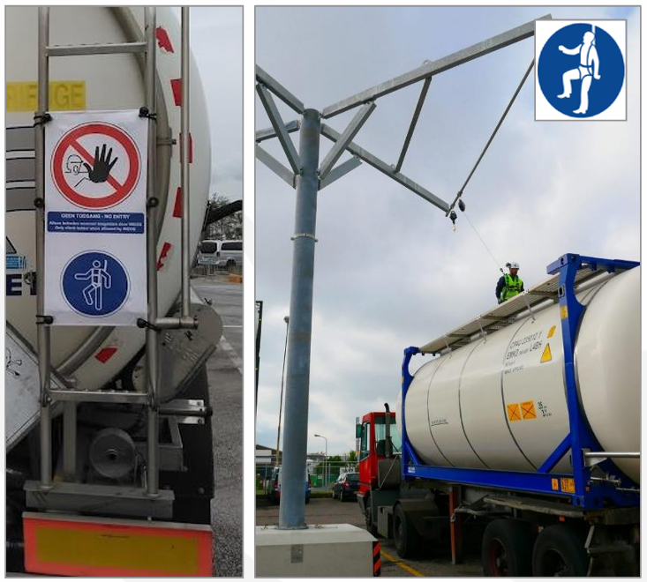
Life Saving Rules (LSR)
Working on height without suitable fall protection
Important:
Before entering, you must place the banner on the stairs of the container or tanker.
The banner may only be removed at locations with personal fall protection.
You can only enter the ladder with a connected fall arrest harness.
You place the banner again after working at height.
When leaving the site, the banner must be returned.

Slide 7
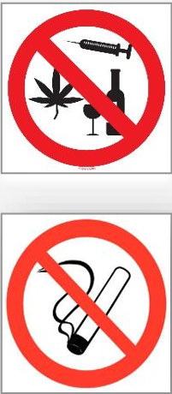
Life Saving Rules (LSR)
Being under the influence of alcohol or drugs.
Smoking/Vaping unless in the designated places.
Practical:
Having, using or being under the influence of alcohol and drugs is prohibited.
Smoking on the site is generally prohibited. There is an exception to specifically assigned locations.
Smoking in your vehicle is also prohibited.

Slide 8
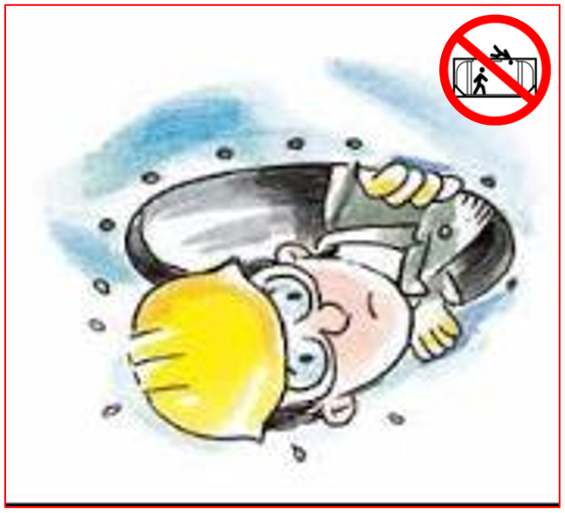
Life Saving Rules (LSR)
Entering confined spaces
Practical:
Entering the tank is strictly prohibited.
Never put your head in a manhole.

Slide 9
Life Saving Rules (LSR)
Below again all 7 Life Saving Rules. Strictly prohibited:
Working at height without suitable fall protection.
Being under the influence of alcohol or drugs.
Smoking/Vaping unless in the designated places.
Entering confined spaces.
Entering the danger zone during lifting work.
Working on installations without permission.
Bypassing of safeties or interlocks.
Any breach is life-threatening. Any finding leads to a permanent ban on the site.

Slide 10

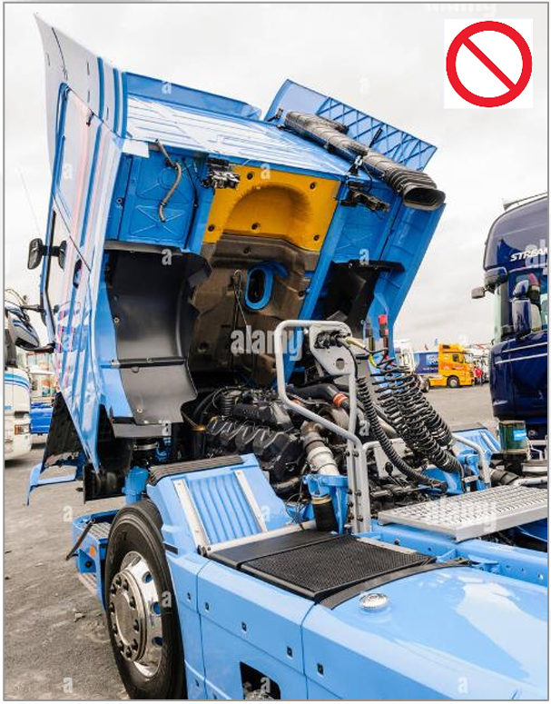
General Safety rules
The use of electronics is prohibited in the production areas. These zones are marked by an orange line. This includes all loading and unloading points of chemicals. This rule also applies in your vehicle when in an orange zone.
Photography is prohibited on the entire site.
Operating loading or unloading installations is prohibited. (e.g. leaf arm, cage, stairs, ... )
Working on your vehicle is only allowed after approval from Ineos.

Slide 11
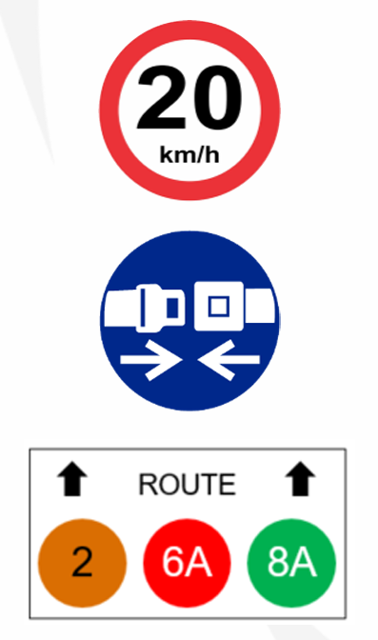
General Safety rules
The maximum speed on the site is 20 km/h.
Wearing a seat belt is mandatory.
There is a circulation plan for heavy traffic. Always follow the specified route.

Slide 12
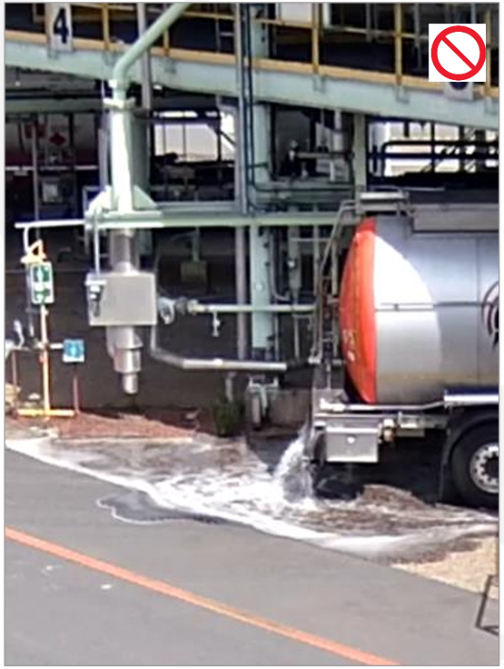
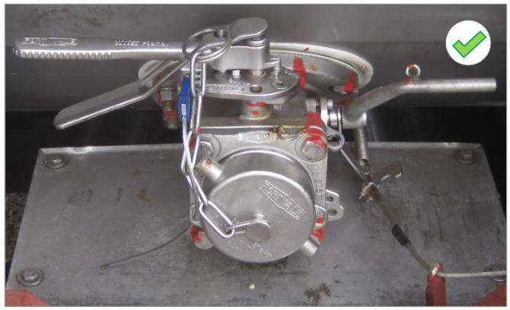
General Safety rules
Before entering, check that the bottom valves are closed.
Checking in at the loading point with the valves open leads to an entrance ban.

Slide 13
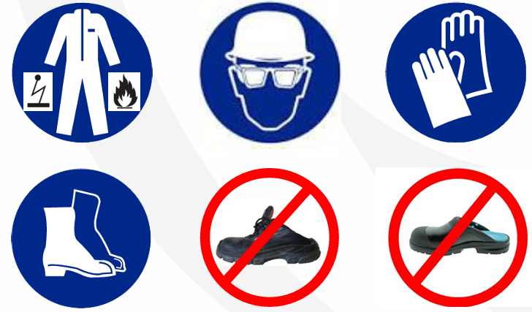
Personal Protective Equipment (PPE)
Loading and unloading locations are operational zones. These are marked by an orange line on the ground. Basic PPE is mandatory.
  Safety helmet
  Safety goggles
  Safety shoes
  (prohibited: open or flattened back)
  Antistatic fire protection work clothing
  (prohibited: short sleeves or short trouser legs)
  Work gloves
Additional PPE (acid suit, face shield, etc.) may be required. Always follow the instructions based on pictograms on the loading place

Slide 14

Emergency measures
Fire alarm: (= ascending tone)
  Clear the road.
  Stop the engine.
  Wait in your vehicle for instructions.
Evacuation alarm? (= wavy tone)
  Immediately proceed to the evacuation point on foot.
  Move perpendicular to the wind direction.
  Don't forget to badge out.
  Study the site plan for evacuation points!
Stop alarm? (= continuous tone):
  Traffic may be resumed.

Slide 15
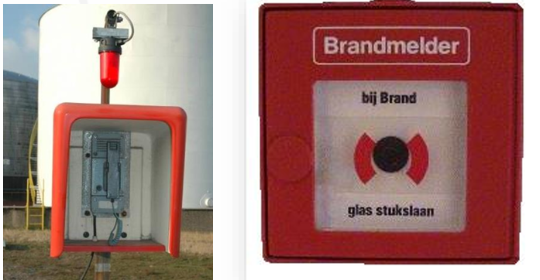
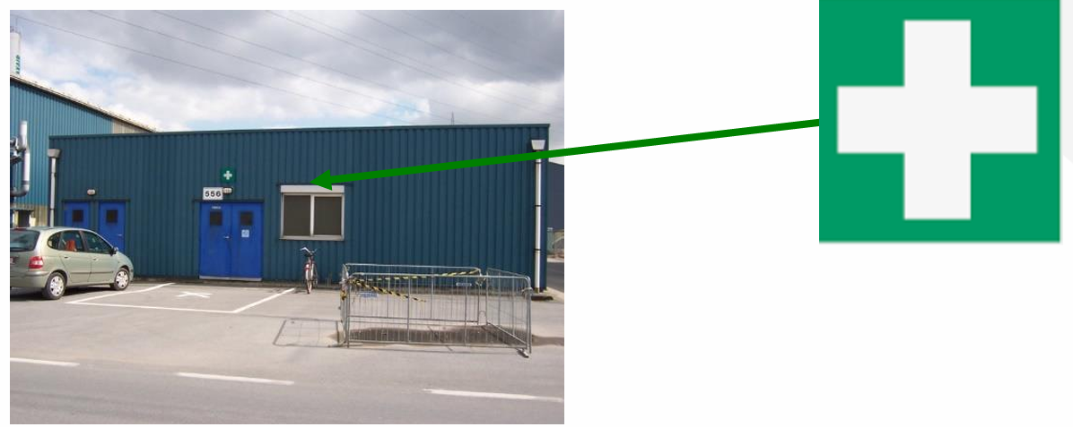
Emergency measures
In the event of an emergency, always call for help:
  Speak to an INEOS operator or employee
  Alarm devices (Red hotlines, intercom).
  Telephone number internal '555'.
  Telephone number external +32 (0) 3 250 95 55
Any injury must be treated at the medical service

Slide 16
Summary
Safety first. When in doubt, stop.
Alcohol and drugs are prohibited.
Smoking is prohibited, including in the vehicle.
Work only with protection at height. The handrail alone is insufficient.
Never put your head in a manhole.
Always wear the correct PPE.
Follow the specific instructions at the loading location.
Close your bottom valves before entering.
We wish you a pleasant and safe visit!

